Slide 1
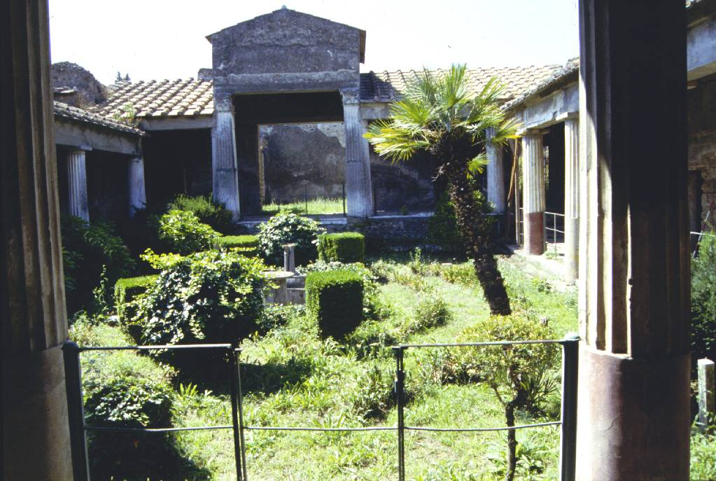

Getting your fingers burnt with on-line interactive publishing:
Pompeian resources
Penelope Allison
School of Archaeology and Ancient History

Slide 2
www.stoa.org/pompeianhouseholds
c. 3000 hits month (Oct. 2011)
www.stoa.org/menanderinsula/
c. 900 hits month (Oct. 2011)

Slide 3
Where to start this history?
“Pompeian Households”
2004 – Publication of book and on-line resource
2001 – Stoa Consortium takes on dataset
Late 1990s - Cotsen Institute for Archaeology publications
– new digital division
1995 - Book accepted for publication by Cotsen Inst.
1987 – Began data collection in Pompeian excavation archives
1826 – Earliest excavations used for this dataset

Slide 4
Setting up on-line resource - from 2001
Correspondence with Stoa Consortium and Cotsen Institute
Data sent directly from Cotsen Institute to Stoa Constortium
- Big mistake!

Slide 5
Setting up the site - from 2001
Correspondence with Stoa Consortium
Data sent directly from Cotsen Institute to Stoa Constortium
- Big mistake!
On-going communications and testing with Ross Scaife
Copyright agreements
– ‘copyleft’
- copyright agreements with Pompeian authorities

Slide 6
Going public to a deadline
(October 2004)
Problems with data format and design

Slide 7
Going public to a deadline
(October 2004)
Problems with data format and design
Errors in data content

Slide 8
Going public to a deadline
(October 2004)
Problems with data format and design
Errors in data content
Clunky searches

Slide 9
‘Few scholars choose to present their research data through an interactive website. For this Allison ‘s initiative is to be praised, as it gives others the possibility of evaluating the evidence in various ways. However, some comments need to be made. Allison has chosen not to include these data in the book, which is understandable because of considerations of size and price, but it may cause some inconvenience for students working in libraries that lack a ready internet-connection. Worse, the website is all but user-friendly: the layout is inconsistent and does not seem to have anything to do with the layout of the book. It requires some experience with data-bases to do the searching: the search form only allows the user to search one data-field at a time, so that one has to begin by choosing the field to be searched. Given the many strange abbreviations in the field-names, that is no sinecure. For example, what kind of data must we, on first sight, expect to be found in fields called “gdsc” and “invno”. If one accidently enters a search term that returns no result, the server simply returns a blank page with an error message which, unless one understands SQL, is rather enigmatic. The data themselves are rather unpolished, again consisting of many abbreviations and (numeric) codes. In short, publishing a data-base should be more than simply putting it online. The needs of the researcher compiling the data-base differ markedly from those of the reader using it, and this should be taken into account when programming the website and adapting the database. That being said, once one has become used to Allison’s abbreviations and codes, the website proves to be valuable source of information and gives scholars not only the opportunity to check her argument, but to enrich their own work with data that were, until now, hardly accessible outside Pompeii. One may hope that online publication of searchable data-bases will become common practice in the near future.’
Miko Flohr, Journal of Roman Archaeology 18 (2005): 587-590

Slide 10
The story does not end there …
(2004- 2008)
Correcting data
Corrections to the text of the house by house analysis (XML editor)

Slide 11

The story does not end here …
(2004- 2008)
Correcting data
Corrections to the text of the house by house analysis (XML editor)
Corrections to databases - on-line
- http://seneca.stoa.org.phpgAdmin
Ross Scaife died of cancer in March 2008
Maintaining interactive components
SVG map

Slide 12

Change of strategy
Insula of the Menander: Finds in Context
No funds for development of Stoa Consortium on-line resource
Mirrored on University of Leicester
– Richard Mobbs - Manager of Web & eLearning Services

Slide 13
Change of strategy
Insula of the Menander: Finds in Context
No funds for development of Stoa Consortium on-line resource
Mirrored on University of Leicester
– Richard Mobbs - Manager of Web & eLearning Services
A few hiccups
Permission for archive images of silver in Naples Museum
Clunky searches
Richard Mobbs – retired in 2008
Change of platform

Slide 14
Feasibility and practicality of on- going maintenance
Funding?
Pompeian Households
- book publisher & university grant for development. - Stoa Consortium for maintenance
Menander site
- University of Leicester and me.
Time??
REF 2014 impact???
Engendering Roman Space - on ADS

Slide 15
What can we learn from this?
Conceptualisation of end product and its capabilities
- technicians, producers, users - not always on same page
    reliance on advise and support from computer technicians (i.e. individuals)
    own familiarity with own data and how it functions
Processes for data corrections and monitoring of corrections
- keep a log
- maintain communications
Formats of final data
- keep own copies of all final data in useable form
- migrate on your own platform as appropriate.
Allocation of time and funds for on-going maintenance
- relationships with research assessment exercises

